Slide 1
Implementation of Urban Tree Canopy Assessments within the Chesapeake Bay Watershed
Preliminary Results
Lele Kimball
October 18, 2013
UTC Workshop – Virginia Tech

Slide 2
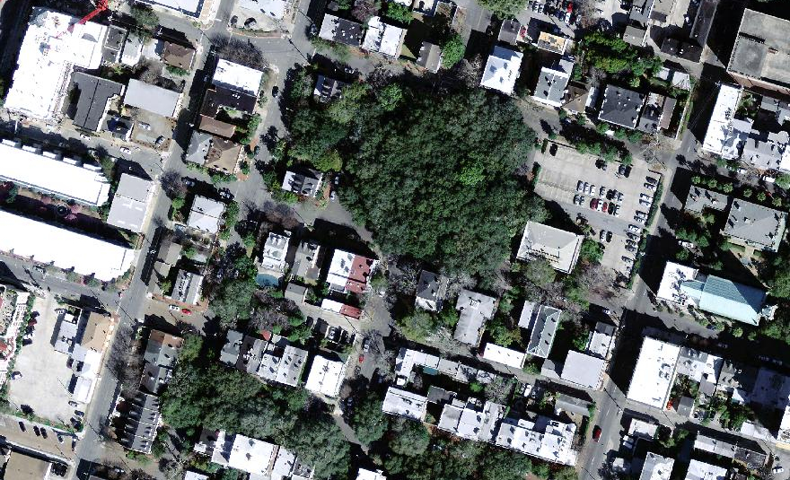
Urban Tree Canopy
Watershed Forestry Resource Guide - Urban Tree Canopy
Economic Benefits
Social Benefits
Environmental Benefits

Slide 3
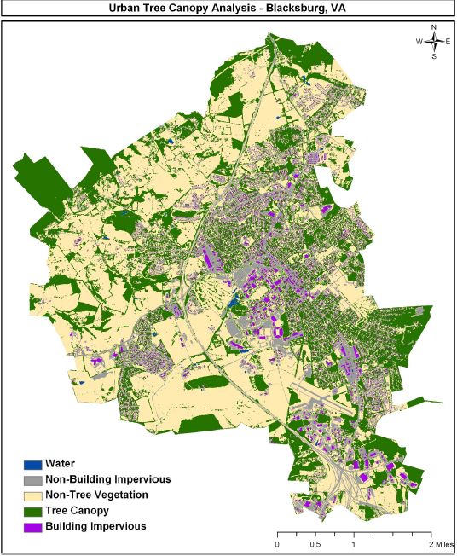
Urban Tree Canopy (UTC) Assessment
  Measures amount of both existing and possible UTC
  UTC assessment is data!
  Can help decision makers effectively design and implement the urban forest
McKee, J. (2009).

Slide 4
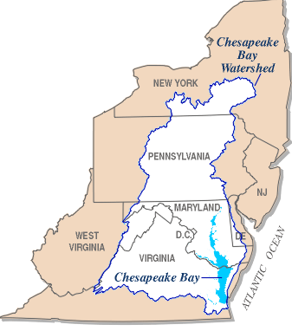
Chesapeake Bay Watershed
Continues to experience population growth and increasing urbanization¹
  Currently 17 million people
  150,000 more people each year
  Nearly 65,000 mi. sq.
Loses about 100 acres of forest per day²
By 2010, five communities in each state with:
  Completed assessment
  Canopy goal adopted
  Measures to attain the goal
120 communities with UTC expansion goals by 2020
Washington Gas Energy Services, Inc. (WGES)

Slide 5
Research Questions
How are localities in the Chesapeake Bay watershed using UTC assessments?
Are there ways to increase the use of those assessments?

Slide 6
Methods
Web-based survey sent to each locality within the Chesapeake Bay watershed with a UTC assessment
Approximately 9.2% of the area in the watershed has a UTC assessment
Total of 100 counties, cities, and towns/boroughs (PA)
Population range from 2,500 to 1.1 million
Area range from 0.5 sq. mi. to almost 1,000 sq. mi.
Washington Gas Energy Services, Inc. (WGES)

Slide 7
55% response rate from localities
Representing :
  80% of total area with UTC assessment

Slide 8
67% of localities aware of their UTC assessment
Positive bias due to non-response?

Slide 9
Most Common types of Uses
85%
Educate public and officials about tree canopy

Slide 10
Most Common types of Uses
65%-75%
Create a
locality-wide
tree canopy
goal
Plan and prioritize tree plantings
Baseline for canopy change
Inform larger initiatives

Slide 11
Advanced Types of Uses
Financial and Public Buy-In
In-Depth Goal Setting and Prioritization
Informing and Enforcing Tree Preservation in Policies and Planning
Gathering Data for External Leveraging
Educate public and officials about tree canopy
Plan and prioritize tree plantings
Create a locality-wide tree canopy goal
Inform larger initiatives
Baseline for canopy change

Slide 12
Advanced Types of Uses
Financial and Public Buy-In
In-Depth Goal Setting and Prioritization
Informing and Enforcing Tree Preservation in Policies and Planning
Gathering Data for External Leveraging
Educate public and officials about tree canopy
Plan and prioritize tree plantings
Create a locality-wide tree canopy goal
Inform larger initiatives
Baseline for canopy change

Slide 13
Advanced Types of Uses
Financial and Public Buy-In
In-Depth Goal Setting and Prioritization
Informing and Enforcing Tree Preservation in Policies and Planning
Gathering Data for External Leveraging
Educate public and officials about tree canopy
Plan and prioritize tree plantings
Create a locality-wide tree canopy goal
Inform larger initiatives
Baseline for canopy change

Slide 14
Advanced Types of Uses
Financial and Public Buy-In
In-Depth Goal Setting and Prioritization
Informing and Enforcing Tree Preservation in Policies and Planning
Gathering Data for External Leveraging
Educate public and officials about tree canopy
Plan and prioritize tree plantings
Create a locality-wide tree canopy goal
Inform larger initiatives
Baseline for canopy change

Slide 15
Staff Expertise and Training
Localities with:
less likely to be using assessment in sophisticated ways.
“lack of staff expertise” =
“staff trained or attended a workshop on how to use = UTC data”
more likely to be using the assessment but not necessarily in more sophisticated ways.
So training perhaps is only introductory?

Slide 16
Biggest Opportunities
For Future Use
Financial and Public Buy-In
In-Depth Goal Setting and Prioritization
Informing and Enforcing Tree Preservation in Policies and Planning
Gathering Data for External Leveraging

Slide 17
Biggest Opportunities
For Future Use
Financial and Public Buy-In
In-Depth Goal Setting and Prioritization
Informing and Enforcing Tree Preservation in Policies and Planning
Gathering Data for External Leveraging
Plan and prioritize tree canopy conservation
Plan and prioritize outreach
Develop sub-locality level tree canopy goals

Slide 18
Implications
Currently UTC assessments are underutilized.
Raising awareness may increase the number of localities using UTC assessments.
Lack of staff expertise constrains more sophisticated uses.
Need to increase staff expertise.
  How to do this?
  Through training? If so, need to investigate effectiveness of training and have in-depth training.
Biggest opportunity for that training may be in in-depth prioritization and goal setting.

Slide 19
Questions?
References
Ruark, E. A. (2010). Immigration, Population Growth and the Chesapeake Bay: Federation for American Immigration Reform.
Chesapeake Bay Program. (2012a). Facts and Figures. Retrieved 9/28/2012, from http://www.chesapeakebay.net/discover/bay101/facts
Figures and Photos
"Watershed Forestry Resource Guide - Urban Tree Canopy." Watershed Forestry Resource Guide. Accessed 14 Oct. 2013. <http://www.forestsforwatersheds.org/urban-tree-canopy/>.
"Washington Gas Energy Services, Inc. (WGES) ." Washington Gas Energy Services, Inc. (WGES). Accessed14 Oct. 2013. <http://www.wges.com/page/CleanStepsOffsets.html>.
McKee, J. (2009). UTC Report for Blacksburg, VA. Blacksburg, VA: Virginia Tech.

